Slide 1
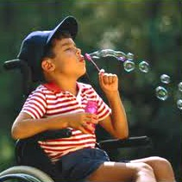



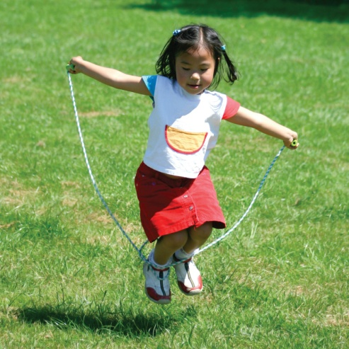


Ending Childhood Lead Exposure from Contaminated Soil
Susan M. Browning, MPH
Executive Director
Lead Abatement resource center
Notes:
.

Slide 2
Overview
Charitable Private Operating Foundation est 2014/BoD
Despite efforts of last 2 decades, lead poisoning remans serious problem in Chicagoland area; esp for children of color and those in econ. disadvantaged communities
Mission: To end soil-based lead exposure in children and other at-risk populations
Notes:
Env justice - early initiatives in GEW

Slide 3
Our Focus – Educate, Partner, Advocate
1. Increase community awareness re: the legacy of lead-contaminated soil and its health hazards
2. Partner with individuals and organizations to abate – or clean up – lead contaminated soil in public spaces, playgrounds, and yards
3. Commitment to social justice; focus early initiatives in Greater Englewood Area

Slide 4

Magnitude of the Problem
Chicago (2002) – Highest childhood lead poisoning rate in the nation
2019 - Still ranks among the top 8 highet -risk cities for lead poisoning
(Pittsburg #1)
Children of color in low income, limited access communities disproportionately
at risk
“Cluster areas” in Chicago where lead poisoning over 5x national average
Disparities unduly burden minority/ low income families and their communities
Multidisciplinary matter spanning environmental justice, public health
Notes:
Interest in preventing childhood lead exposure and its harmful effects is high among a broad group of stakeholders is high – brief video on the problem

Slide 5
Research Findings
Lead exposure risk factor for:
• Behavior disorders (ADHD, delinquent)
• Learning deficits
• Diminished intellectual abilities
VERY small increase blood lead in children (1-4 BL) = 3.7 point decrease in IQ
Preschool population most vulnerable
There is no safe level of lead exposure in children (CDC Guidelines, 2012)
Results of exposure are irreversible.
Notes:
When children play in lead contaminated soil, we know that their brain and nervous system is negatively affected.
Fewer children fall into the “gifted” category, while more children fall into the “challenged” category, unable to reach their full cognitive potential
This increased vulnerability d/t several factors, including (1) young children more likely to play in dirt and place hands in mouth; thereby increasing opp. for soil ingestion; and 92) child's GI tract is "more efficient" at absorption of lead than an adults.
When children are exposed to lead hazards, their brain and nervous system is negatively affected. They may suffer hearing and visual impairments, slowed growth, and headaches. They may also develop behavior and learning problems, such as a shortened attention span, language or speech deficits, poor performance on math and reading tests, or developmental delays that require special education services.

Slide 6
What Do We Do?
Despite great progress, problem of childhood lead poisoning persists (pockets)
Need to address other sources of lead – beyond paint
Materials and evidence-based methods available to treat lead contaminated soil

Slide 7
Ground Fish Bones
Safe & effective method for the immobilization of lead
-contaminated soils
By-product of commercial fishing industry
Mixed into the leaded soil using a rototiller
Binds to soluble lead compounds in the soil
15-year track record of successfully reducing toxic lead levels in yards and public spaces

Slide 8
Summary
  Impact of lead exposure is potentially devastating (individually and community-wide.)
  Much progress made in reducing childhood exposure to lead from such hazards as paint and water in the learning environment
  A lot more to do! Goal – eliminate all sources of lead.
  Next target for elimination – soil in and around school yards frequented by the <6 population; group most at risk

Slide 9
Thank you!

