Slide 1
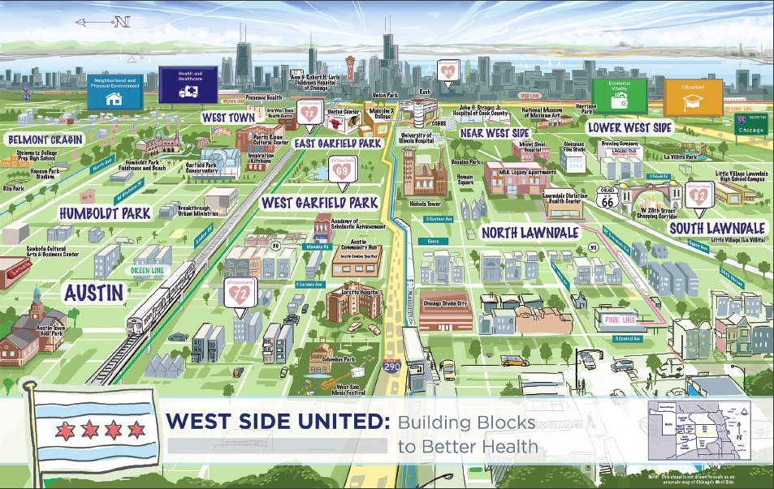
West Side United Overview

Slide 2
Update
Challenge
History
Progress
Governance

Slide 3
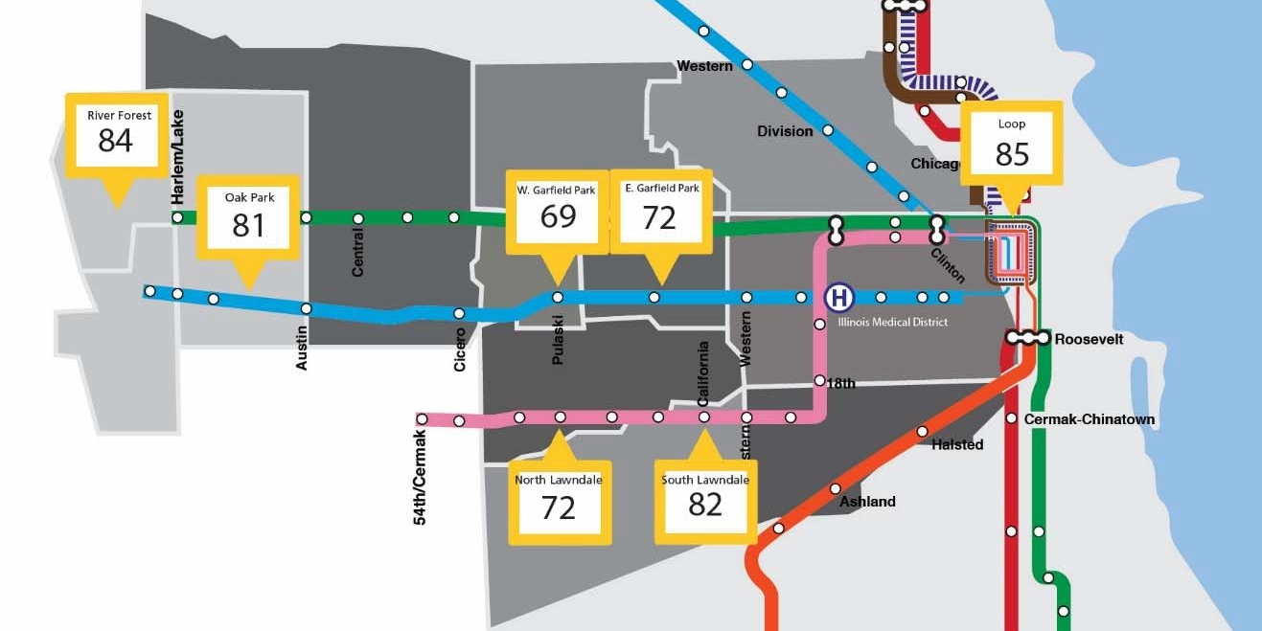
  OUR CHALLENGE:
  16‐year gap in life expectancy between the Loop and West Side Communities
Life expectancy (Years) at Birth By Neighborhood

Slide 4







MISSION
To build community health and economic wellness on Chicago’s West Side and build healthy, vibrant neighborhoods.
VISION
To improve neighborhood health by addressing inequities in healthcare, education, economic vitality and the physical environment using a cross-sector, place-based strategy.
Partners will include other healthcare providers, education providers, the faith community, business, government and residents that work together to coordinate investments and share outcomes.
GOAL
To reduce the life expectancy gap between the Loop and Westside neighborhoods by 50% by 2030.

Slide 5
West Side United’s principles
Partnership with communities to drive priorities and execute initiatives
Increase visibility and scale existing programs that work at the community level
Together, health institutions are able to magnify their impact through collaboration and distributed leadership
Leverage private sector resources and expertise to ensure meaningful progress to life-expectancy goal
Health and
Healthcare
Neighborhood and Physical Environment
Economic
Vitality
Education

Slide 6
Update
Challenge
History
Progress
Governance

Slide 7
Our Journey to Date
Convening at Malcolm X College
Jan 2017
Planning Committee formed
Aug 2017
Focus area Working Groups formed, initiatives launched
2017-2019
2017
2018
2019
Feb 2017
West Side Anchor Committee formed
Mar-Jul 2017
Listening Tours held, “What We Heard” Report published
Feb 2018
Official WSU launch event
Dec 2018
Leadership Council formed
TODAY!
A Case Study for Health Equity

Slide 8
Update
Challenge
History
Progress
Governance

Slide 9

2019 Priority Initiatives
Health & Healthcare | Launch ‘Live Healthy West Side’ a community health framework that promotes health and well-being around 2 health conditions: Hypertension Management Maternal and Child Health
Economic Vitality | Over the next 3 years: Triple commitment to Impact Investing reaching $7.5 million Increase WSU institutions’ local hiring by 15% (~3,500 new West Side hires by 2021) Increase local spend dollars by 20% (~100 Million invested in West Side communities) Expand Small Business Grant Pool to $500,000 per year leveraging new external funders Expand Employee Professional Pathway Programs to include 3 more career paths
Neighborhood & Physical Environment | Launch a Healthy Food Voucher program to provide fruits & vegetables to 1,000 West Side residents by 2021 Support 3 CPS schools in complying with CPS Nutrition Education standards and policies Strengthen direct support relationships with food pantries to provide wrap around services such as SNAP enrollment
Education | Increase High School internships by 50% from 400 to 600 seats Support the development of community hubs at up to 2 schools to expand wrap-around services Establish career exposure programs at up to 4 elementary schools on the West Side

Slide 10
Health and Heathcare
In 2019 WSU is developing a coordinated approach to healthcare interventions
2018
2019
Community Health Action Plan | A working group led by Rush, Sinai and UIH developed a detailed fact base and prioritization framework to support future WSU strategic decision
Launch “Live Healthy, West Side!” Initiative, an overarching strategy to align hospitals’ interventions on priorities that can move the needle on reducing the life expectancy gap: Hypertension Maternal Child Health
Community Health Workers | Awarded $125,000 community health worker grant to Enlace for the 2018-2019 fiscal year, which will help over 1,500 community members access health resources
Co-location of Health Services | Awarded $125,000 in grants to help 3 community-based organization expand access to mental and behavioral health services

Slide 11

Economic Vitality
WSU is expanding job and career opportunities
2018
2019
Local Hiring | Developed multi-institution Local Hiring dashboard, showing that individual institutional efforts resulted in a combined 1,000 West Side hires in 2017
Employee Professional Growth | Launched inaugural Medical Assistant Pathway Program (MAPP) cohort, a collaborative program bringing together employers, workforce agencies, educational providers, and public/private funders
Launch activities to reach 1,150 West Side local hires across all institutions by 2021 (15% over three years) Hiring fair
Scale employee professional growth pathway program MAPP cohort 2 Health IT Nursing Assistant Nursing
*) UIC not included

Slide 12
Economic Vitality
WSU is committed to increase support for local business
2018
2019
Business Development | Engaged multiple institutions in WBC laundry/linen effort Developed multi-institution Local Spend Dashboard, showing that hospitals^{*)} collectively spend approx. 30M/ year with West Side vendors
Small Business Grant Pool | Inaugural small business accelerator grant program, resulting in $85K awarded to 7 selected businesses from over 106 applicants. Funding provided by Rush, AMITA, Lurie and Northern Trust
Launch activities to increase local spend from $31M to $37M by 2021 (20% over three years)
Expand the Small Business Grant Pool program to $500K in grants
*) UIC not included

Slide 13
Neighborhood & Physical Environment
In its first year, WSU piloted a mechanism to deploy investment resources
2018
2019
Impact Investing | Allocated $2.6m to provide loan capital for business or community initiatives on the West Side (Rush, Lurie, IMD) Tested new model of community-driven investing, resulting in initial $1.7M allocated to affordable housing and community organization capital improvement projects JPMC Service Corps completed pro bono study on future fund models
Triple direct impact investments from $2.5M to $7.5M* (total of $10M since WSU’s launch) in community- supported West Side projects leveraging new non-WSU investors

Slide 14
Neighborhood & Physical Environment
In 2019 WSU is starting implementation of initiatives to increase access to healthy food
2018
2019
Healthy Food Access | Conducted analysis of food insecurity drivers and identified high-priority initiatives Established working group, and began planning and execution of implementation
Launch Adopt-A-Pantry program to strengthen emergency food network Launch nutrition education program in 6 West Side CPS schools Launch Fruits and Vegetables Voucher program for 1,000 West Side residents

Slide 15
Education
The collaborative is expanding its focus beyond apprenticeships and internships
2018
Increase the number of High School Internships
600 Summer Internships Create unifying Education Strategy to guide future WSU investments and support for community partners Community Hubs and wrap-around services in schools Career exposure program in elementary schools
2019
Internships & Apprenticeships | Set up education working group and established baseline for summer internships (~400 for WSU) Collected data from hospitals on breadth of programming and current participation in programs, including demographic information Developed playbook to support new employers who want to launch internship program

Slide 16
Since December 2018, WSU is working on a comprehensive metrics’ framework to measure progress
Tier I: WSU Overarching Community Goal
Reduce the life expectancy gap and improve health
Phase 1
Tier II: WSU Domains of Impact
Education
Economic Vitality
Neighborhood & Physical Environment
Health and Healthcare
Tier III: WSU Initiative and Program Level
Health Careers Pipelines
Small Business Grant Pool
Fruit/Veg Voucher Program
Co-Locating Services
Food Insecurity Screens
HS / College Intern Program
Local Hiring & Spend
Phase 2
Community
Hubs
Impact Investing
Community Hubs
Pathway Program
Food Pantry Support
Nutrition Education
CHW Initiatives

Slide 17
West Side United
Progress to-date
Governance
Opportunities

Slide 18
The current Governance Structure was formally approved in December of 2018
Role | Entity | Responsibility
Leadership Council
Defines WSU long term vision, success, and priorities
Secures resources to support WSU and decides funding allocation (operations vs programmatic areas)
Strategy
Operations Committee
Responsible for supporting / augmenting and coordinating WSU’s work within their respective organizations
Coordinates community engagement events, etc
Management
Backbone Structure
  Backbone Structure:
    Responsible for providing the infrastructure and support to execute WSU strategies
    Working Groups:
    Responsible for designing and implementing initiatives across WSU’s focus areas (Health & Healthcare, Economic Vitality, Neighborhood & Physical Environment, Education)
Execution
Working Groups

Slide 19
Membership of the LC will be balanced between Hospitals and West Side community representatives
Leadership Council
Leadership Council
Hospital: 6 + 6
Community: 6
Ex-Officio: 2-3
Leadership Roles: Chair, Vice Chair, Secretary
Key
Voting member
Proxy / non voting member
Community Advisory Council
Non-member
(17 members)

Slide 20
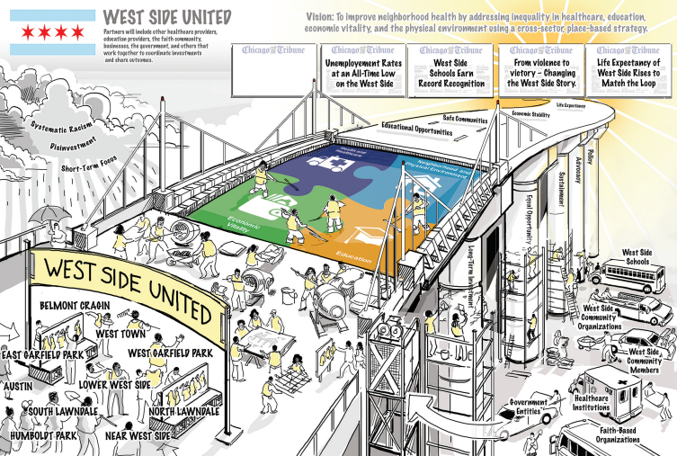
The West Side United Vision

