Slide 1
Institute of Medicine of Chicago
March 21, 2019
Foxglove
6/19/18
Do not distribute with out consent of Cheryl Irmiter

Slide 2
Time together
What we know:
  Community
  Ourselves

Slide 3
Self -Reflection

Slide 4
Problem--Zip Code Matters
Although 60% percent of preventable deaths are rooted in modifiable behaviors and exposures that occur in the community
  our healthcare system is not focused on these factors (1)
Shift of focus on wellbeing including financial, spiritual, emotional, physical, environmental, and social (2).
Social and economic status drives behaviors and behaviors directly impact health outcomes(3).
  “Your zip code matters more than your genetic code” (4)

Slide 5
Opportunity--Collective Social Impact Models
“Aggregating the financial and non-financial impacts across stakeholder groups examines how overall value is created (or destroyed) by the firm with its stakeholders.” (pg 18, Griffin, 2016)
Corporate Impacts: Focusing on Connecting Stakeholders
Jennifer J. Griffin
Professor, Strategic Management & Public Policy
The George Washington University
School of Business
2016

Slide 6
Solution—IOMC can help
IOMC
“represents those who care about the healthcare field, have the positive ability to change the field, and represents leadership giving back to the community”
“an organization which reaches across silos to bring together people and organizations to improve the wellbeing of Metropolitan Chicago”
Board Member/s 2018
  Builds on national efforts
  Demonstrated
    Convener
    Collaborator
    Leadership
  Neutral, nonpolitical organization
  Exhibits exemplary expertise
    Person, public, policy, provider, payor
    Not any one constituency
      providers, insurers, pharmaceutical/device manufacturers or governmental bodies, corporations

Slide 7
Why should IOMC Facilitate the Trust?
Nonpartisan community of health care leaders and Health Systems Organizations in Chicagoland Area
History of successfully leading to impact national trends
Diverse group of leaders with deep experience and connections across the Chicago and suburban area
  representing their beliefs
  bringing diverse institutional experience and scholar
  highlighting the person, public, policy, payer, and provider perspectives
National and local relationships to engage and connect decision makers to identify and close gaps to ensure all have an opportunity for health equity.
Operates as a non-political and social conscious of multi-disciplinary health sector professionals.
Unique opportunity to impact the Social Determinants of Health (i.e, the conditions in which people are born, grow, live, work, and age and may enhance or impede the ability of individuals to attain their desired level of health).

Slide 8
IOMC’s History
    1920 – IOMC developed and distributed the first survey of autopsy rates in hospitals as a mechanism to measure the quality of care.
    1945 – IOMC successfully advocated for the City of Chicago to develop a broader, more accessible, emergency public ambulance service.
    1954 – IOMC successfully developed methodologies, along with the Chicago Commission on Human Relations, to promote and ensure hospitals hire African American physicians.
    1971 – IOMC successfully advocated for changes in the Illinois Medical Practice Act, outlawing unfair practices of fee splitting and kickbacks in health care.
    1999 – IOMC established a partnership with the Portes Foundation, which has distributed over $700,000 to remarkable organizations in the forefront of advancing health in Chicago.
    2001 – IOMC established the Chicago Patient Safety Forum, which helped launch the “patient safety” movement in Chicago.
    2004 – IOMC took the lead in raising awareness of disparities in health care in Chicago by holding the first ever, city-wide Health Care Disparities Conference, resulting in funding for outreach workers to care for 10,000 individuals.
    2008 –IOMC voiced concerns about gun violence with Legislators and hosted leaders to consider remedies.
    2012 – IOMC hosted the first of its State of the Health of Chicago (SOHOC), which focused upon using community health workers to improve health care delivery.
    2015 - As part of its 100th Anniversary activities, IOMC raised over $300,000 which it used for grants to address health disparities in Chicago and to train community health workers.
    2017 – IOMC held its second SOHOC Conference, identifying eight topics of importance to the Metropolitan Chicago Area, particularly: Opioid Epidemic; Gun Violence Prevention; State of the Disabled; State of the Uninsured; Community Health Workers; Social Determinants of Health; Mental Health; Medical Education.
    2018 – The success of IOMC’s community health workers program was acknowledged in a White Paper reporting that 189 Community Health Workers in four innovative programs had been trained and were serving in underserved communities.

Slide 9
How can IOMC Help
Advance National and Proven Trends
Support the investment of the our neighbors and partners
  Foundations
  Payors
  Government
  Corporations

Slide 10
Discussions with Partners
Development/Sales/Opportunities
Meetings
Chicago Department of Public Health
  Julie Morita (2x);
  Anne, Marlita;
  Sheri Cohen
Pritzker
  John Shwan
Wintrust 6/18----considering
Cook County Sherriff
Oak Street Health
Midwest Business Group on Health
MacCarther Foundation
BCBSIL- Stephanie Vomvouras
Cook County Health System
Senator Durbin’s Office
Advocate-Aurora

Slide 11
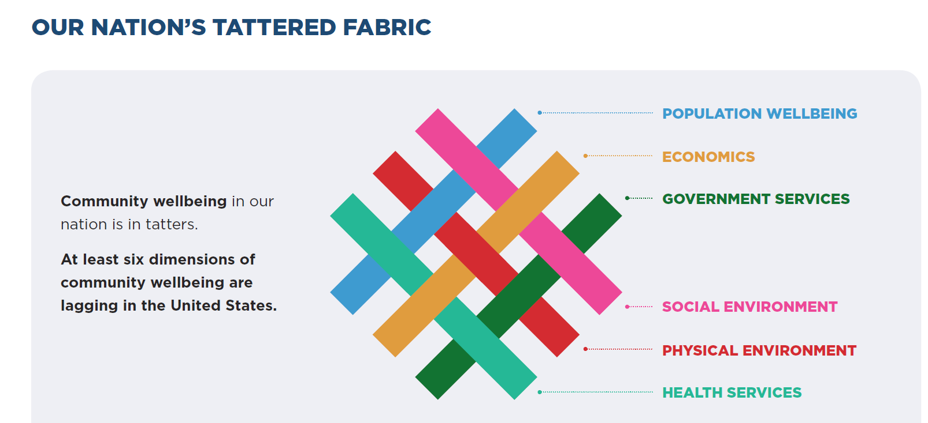
National trends:
WIN- Tighten our threads for sustainability

Slide 12
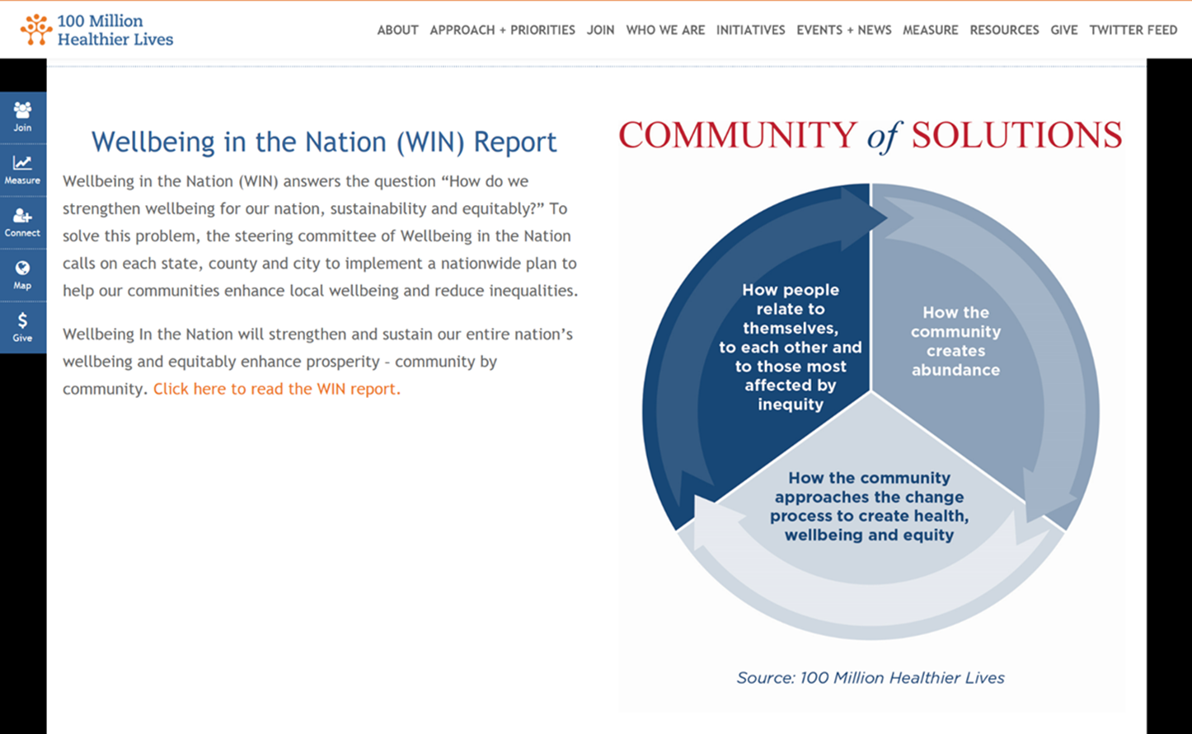
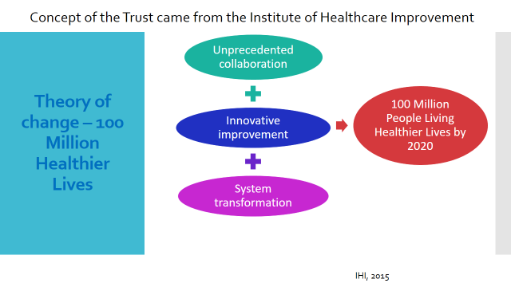
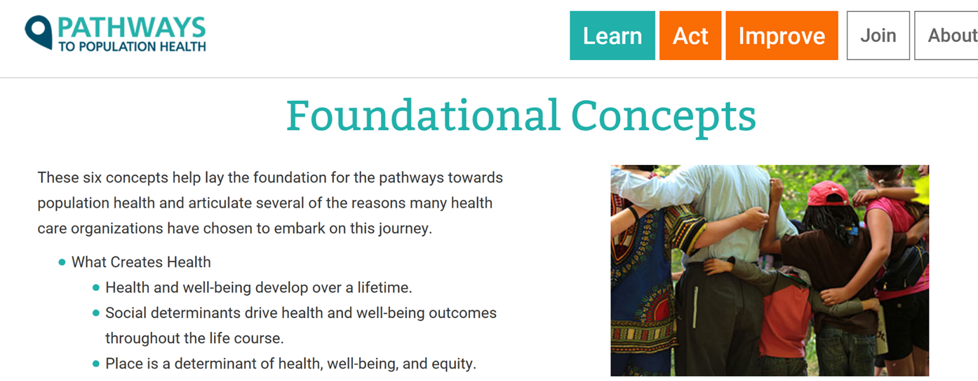
Building on National Momentum: Institute for Healthcare Improvement in 2015
2017
2015
2018

Slide 13
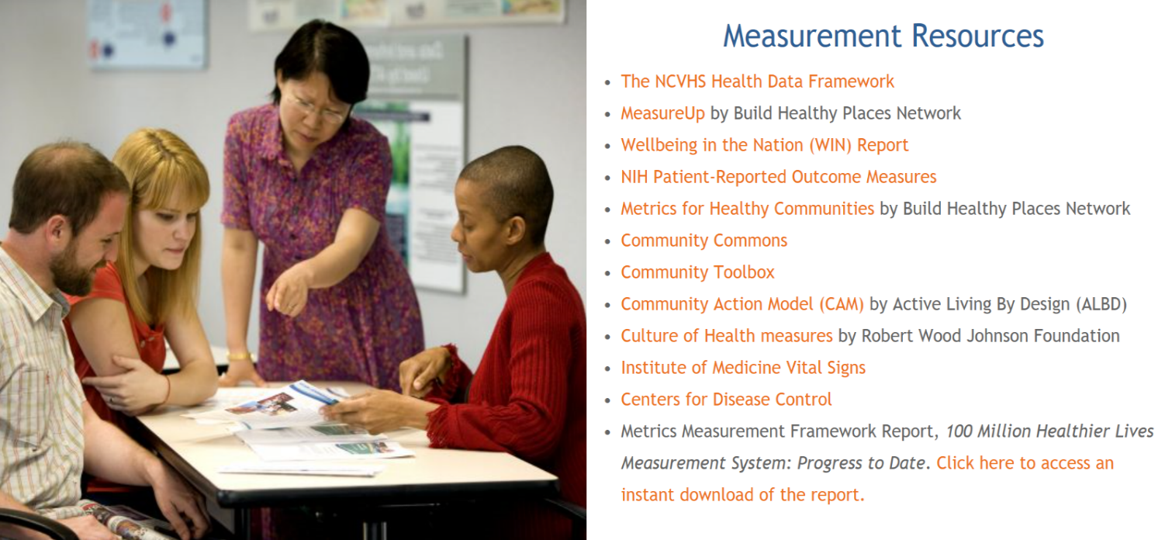
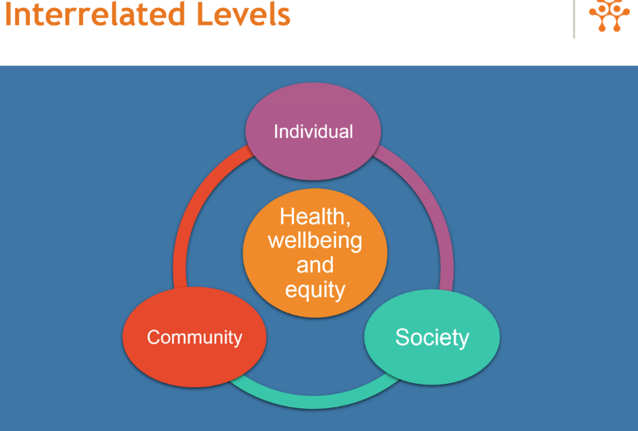
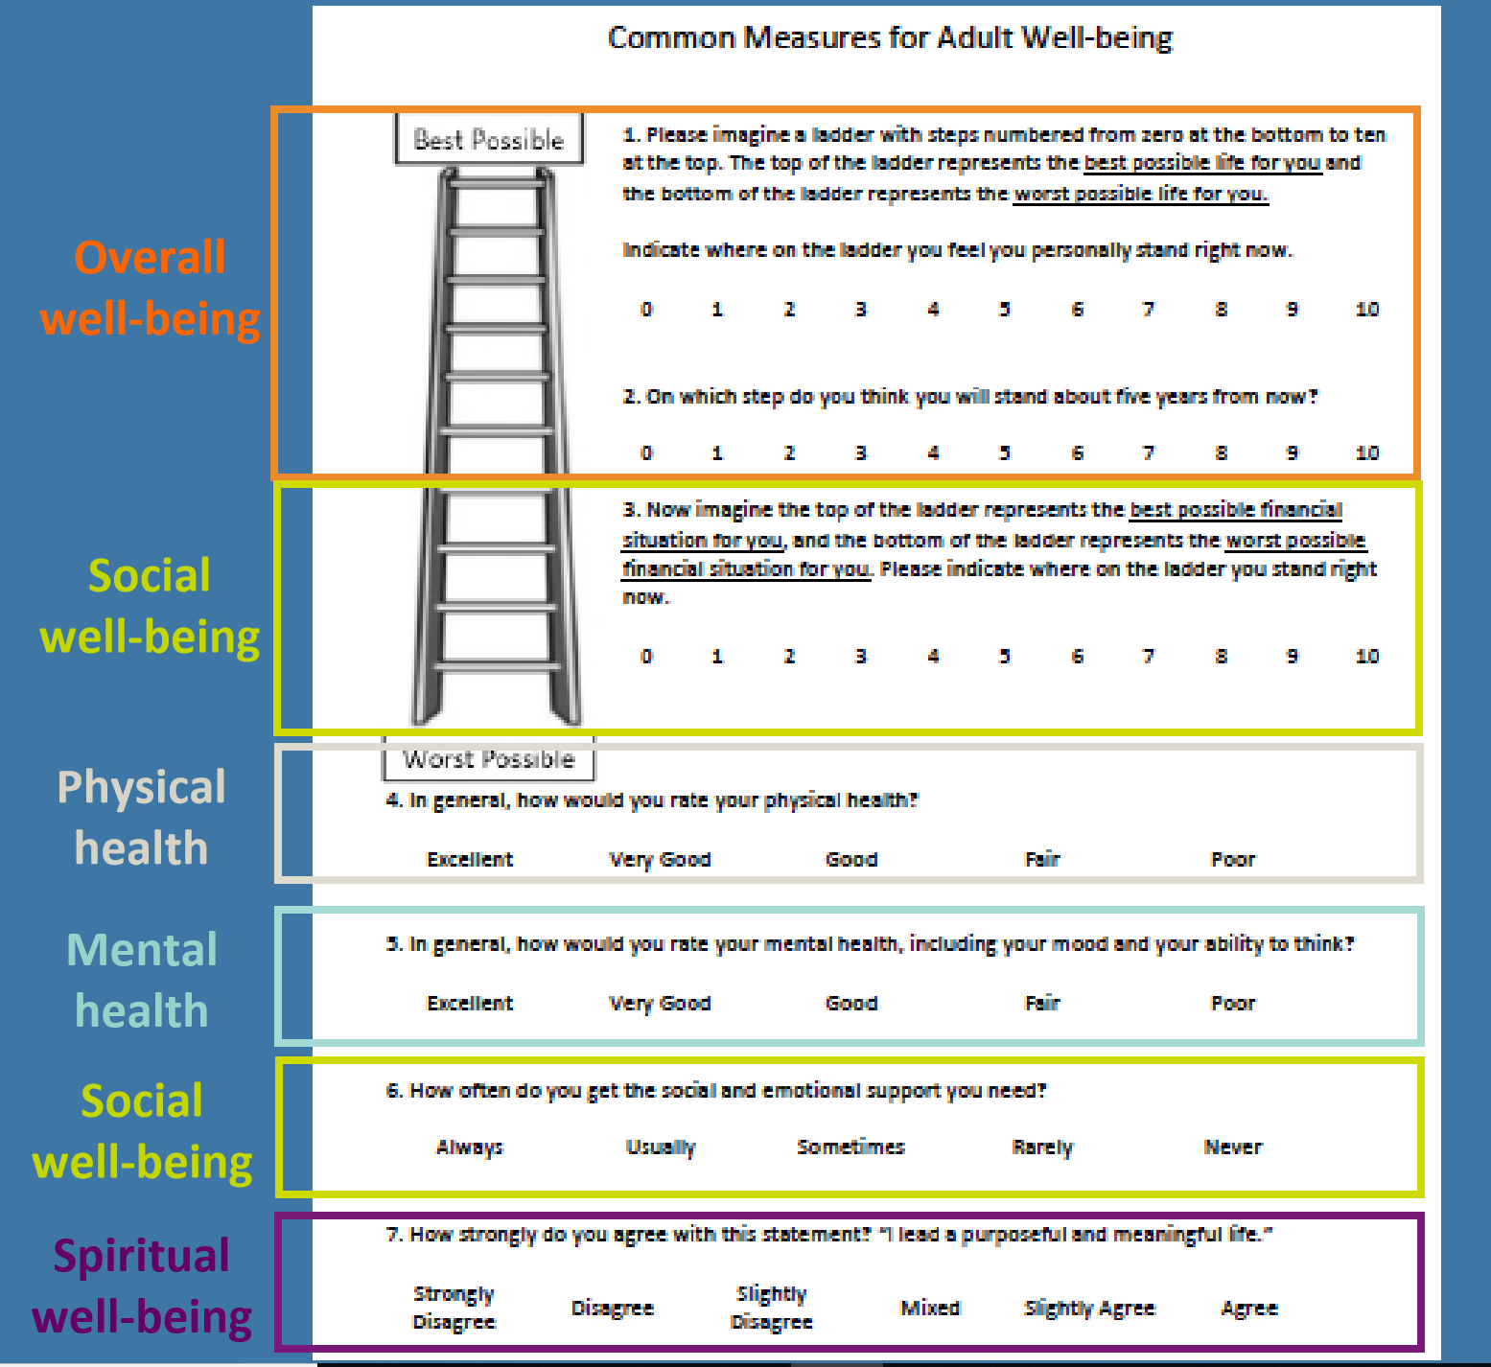
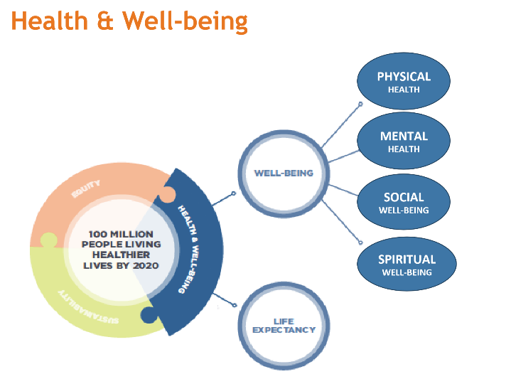

Slide 14
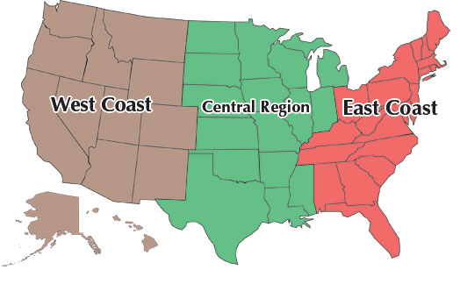
Opportunities-outcomes from Coast to Coast
Colorado
Well Being Trust
Mass Trust

Slide 15
Change Agent-What is a Wellbeing Trust?
Wellness trusts are funds raised or allocated (by governments or private sources) to support primary prevention interventions in community settings to improve population health
Georgia Health Policy Center, Robert Wood Johnson Foundation, 2016; Cohen et. Al, 2015; Timmons, 2007; Cheadle et al, 2008
Romero, D., Echeverria, S., Duffy, M., Roberts, L. Pozen, A. (2018). Development of a Wellness trust to improve population health: Case-study of a United States urban center.
Well Being Trust galvanizes (1) best practices, (2) the shared understanding, the (3) tools and (4) the ‘community will’ that is essential for measurably advancing our local area’s health and well-being.
Norris, T (2017). Well Being Trust Annual Report
Well Being Trust is a platform for health systems and partners across sectors to drive transformative change.
Norris, T (2017). Well Being Trust Annual Report
Working Definition for IOMC—
Metropolitan Chicago Community Wellbeing Trust is a forum and platform for the Chicago and suburban leaders to drive transformative change to improve the health for all in the area.

Slide 16
1) What is needed to change?
2) How can IOMC aid in change?
1a) Assets—Something or someone of any value; any portion of one's property or effects so considered. Any component, model, process or framework of value that can be leveraged or reused or (espionage) intelligence asset.
b) Funding- Support the infrastructure to determine and coordinate the Trust Activities
c) Resources-something that one uses to achieve an objective, e.g. raw materials or personnel
  Data-Chicago Department of Public Health and IPHI; Foundation’s leading pilot programs; Fellows’ Leadership Expertise—Training for Community Agencies to drive quality improvement
2a) Convene (people/public/policy/payers/providers)
b) Collaborate (Fellows/Health Industry Partners/Corporations -neighbors)
c) Sustain Impact (policy, funding recommendations, evaluation/quality improvement consultation, recommendations based on City of Chicago outcomes and local outcomes pre-determined)
d) Disseminate Outcomes (Fellows/organization partners/website, social media; marketing)

Slide 17
IOMC’s Progress
  Doing something meaningful---
  Plan
  Process
    Wish, outcomes, obstacles, purpose
  People
    Those doing similar things
    Champions
    Accountants
    Mentors
    Community
  Possibility
  Proof of concept/similar other/people authorities
  Progress---timeline and meetings
    Design is tomorrow….

Slide 18
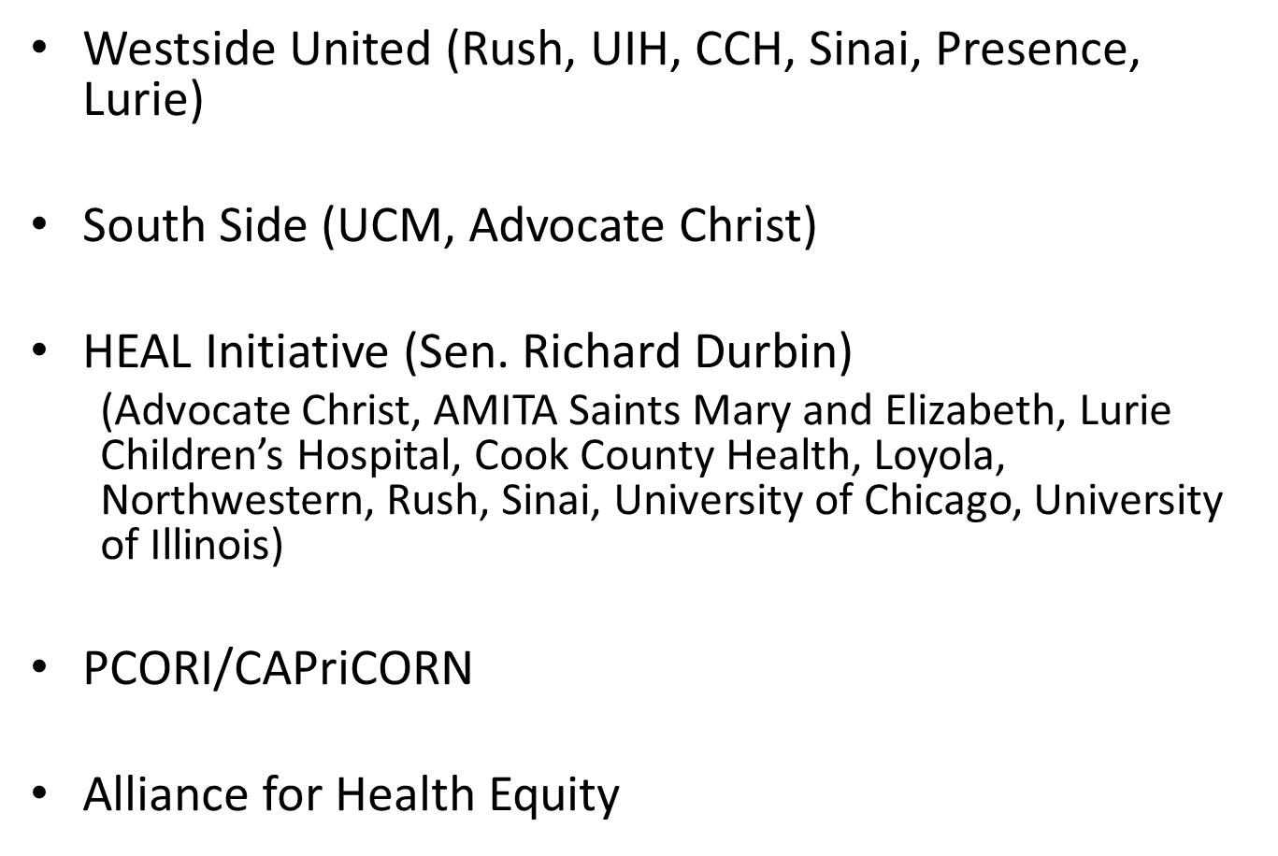
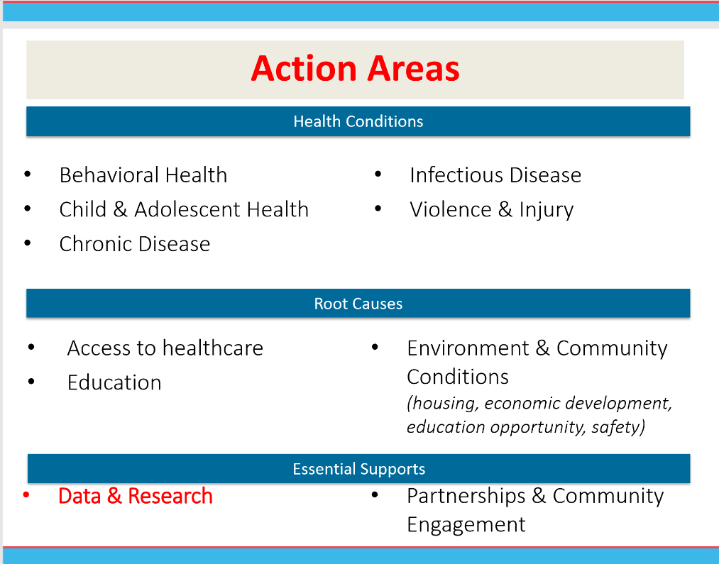
Building on Existing Work at the Local Level
Healthy Chicago 2.0 ---Target Metric for 2020 and beyond!

Slide 19
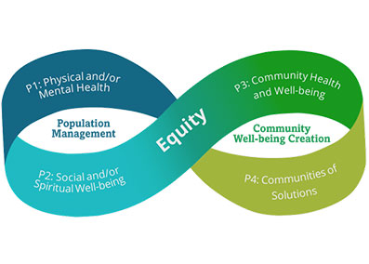
Model
Pathways to Population Health

Slide 20
Process
Inviting our community
  Fellows
  Funders
  Partners
  Community
  Timeline
    Now, engaging Fellows
    Next, funders to complete assessments
      18 to 24 mos.

Slide 21


